Slide 1
Lab 2: Water Tower
Eli Katz, Tate Park, John Szijjarto, Cedric Hollande
Team 11

Slide 2
Activity 1: 3D Structures
Objective: Design a tower using wooden dowels and a 5-gallon water bucket. The water from the bucket will then flow through a tube to push back a puck against an opposing team. The higher the tower the stronger the water flow.
Use only dowels, 3D printed press-fit joints (no hot glue)
Must be assembled in 20 minutes
Must stand up and be able to support 5-gallons of water

Slide 3
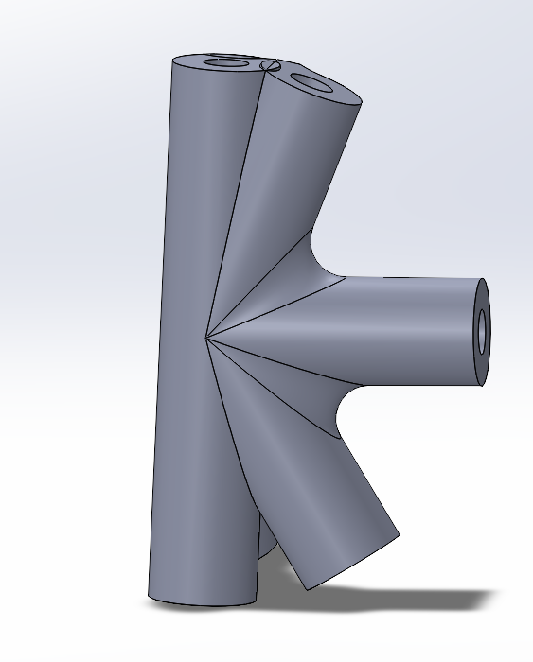
Tower Design
Chosen length = 12.5 in
Values in red were chosen based on:
Area of bucket (8x8in)
3ft pre cut length of dowel
Need for horizontal stability
Joint design constraints - truss configuration - 7
Chosen length = 3ft
Theta 1=67.7
Theta 2=59.7
Theta 3=85
Chosen length = 3ft
Chosen angle = 85 degrees

Slide 4
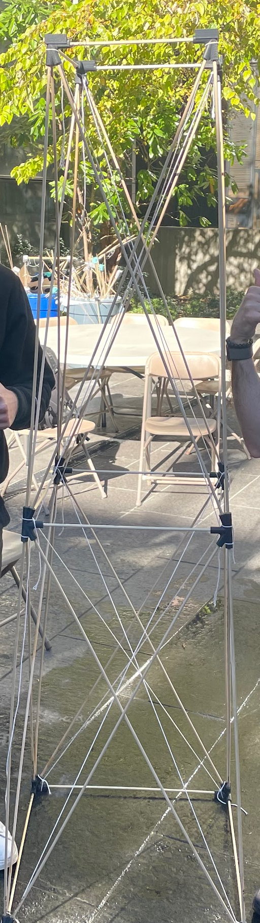
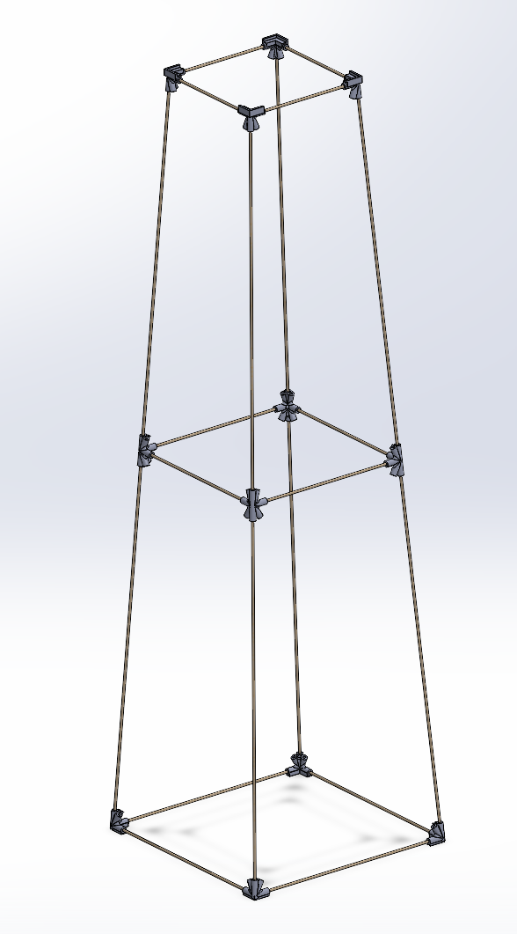
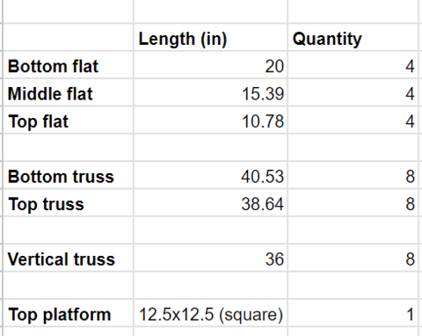
Tower Design
On the final tower, we decided to use tense string to create artificial pre-tensed members to reduce compression on the wooden dowel members
Diagonal trusses not pictured
Tower Dimensions
Tower in Solidworks
Final Tower

Slide 5
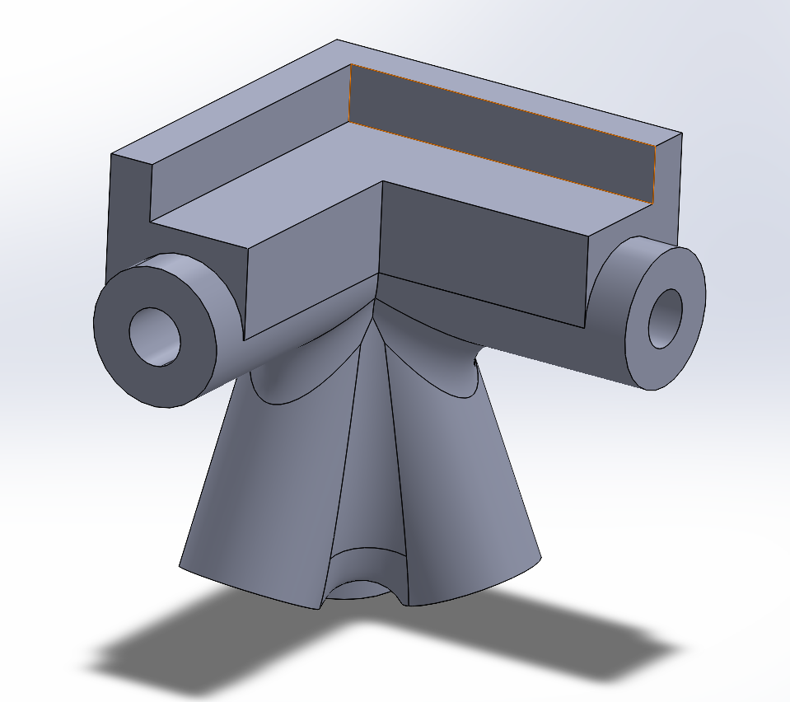
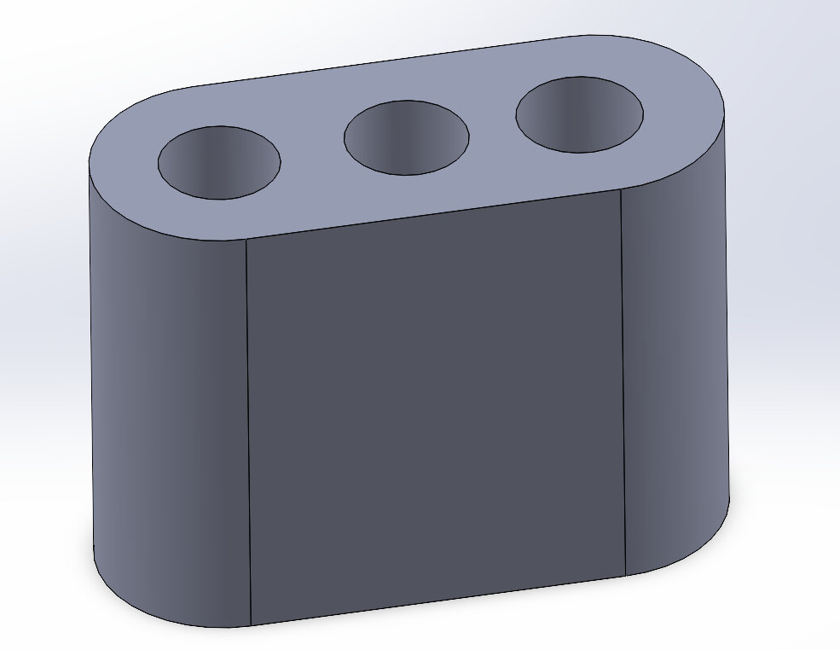
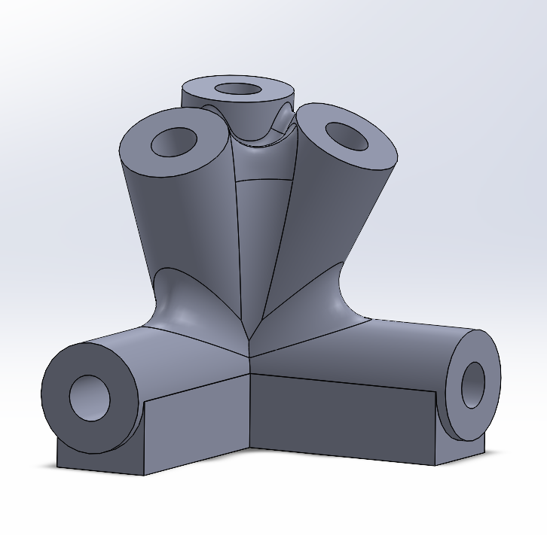
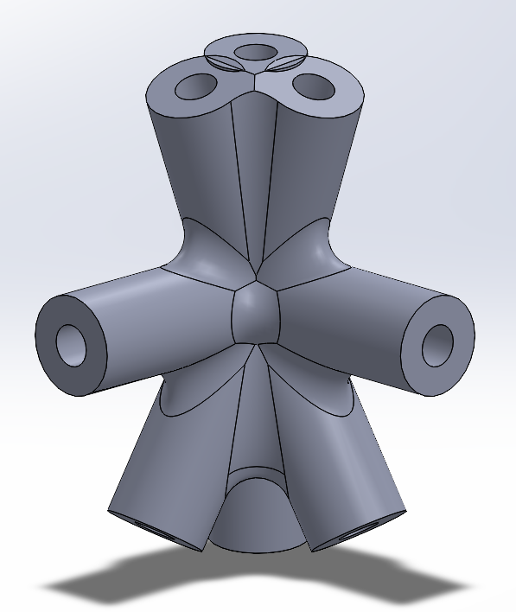
Joint Design
Slots for top platform that holds bucket
Top joint
Press fit tolerance test
Bottom joint
Middle joint

Slide 6
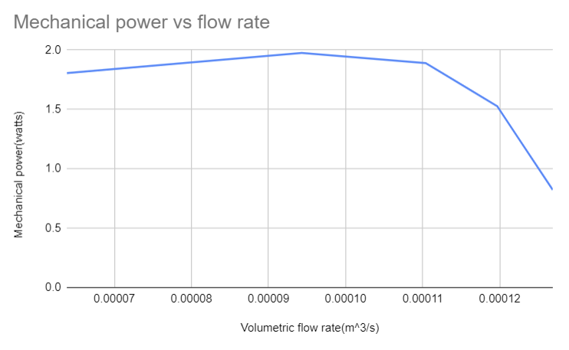
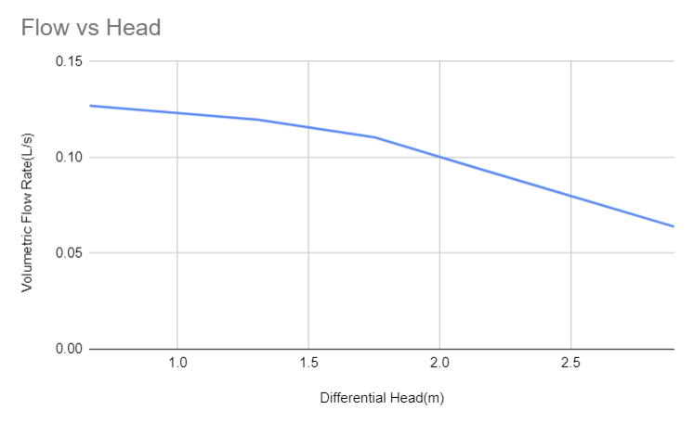
Activity 2: Fluid Flow Against Gravity
Experiment Design: Measured the time to pump 5 gallons of water from one bucket to another placed at varying height intervals.
Water level in first bucket remains constant
Strong, negative correlation between the difference in height of the buckets and the volumetric flow rate (Q)
Plotted mechanical power versus Q to find the maximum energy efficiency
Flow Rate vs. Mechanical Power
Differential Head vs. Flow Rate
Notes:
We were able to measure the flow rate of the pump according to mechanical power and a varying differential head as shown right.
This lets us know that by lowering our differential head, we end up increasing the volumetric flow rate of the water. We will aim for a lower differential head.

Slide 7
Activity 2: Adjusting Tower Design
Predicted bucket fill level based on the height of the tower and associated differential head
Arbitrary fill time of 2.5 minutes = 150 [s]
Initial Height: 9 [ft] ~ 2.74 [m] ⇒ Q_{2.74m} = 6.39E-5 [m³/s] ⇒ V_{2.74m} = 2.53 [gal]
Final Height: 6 [ft] ~ 1.83 [m] ⇒ Q_{1.83m} = 9.43E-5 [m³/s] ⇒ V_{1.83m} = 3.74 [gal]
On competition day, we were able to fill our bucket fully within the time given. It should be noted we were given 3 full minutes of filling on the day of competition.

Slide 8
Activity 3: Gravity Driven Fluid Flow
In Activity 3, we used a “long” and “short” tube with the same diameter, measured height from the top of the staircase, and measured height from the middle of the staircase. Here is a brief breakdown of the experiment parameters (in inches)
Tube Length: Long: 156; Short: 102
Tube Diameter: 1
Height for Long: 137
Height for Short: 63.5
Here is the time in seconds for the tubes filling.
Tube Type | Attempt 1 Time | Attempt 2 Time | Attempt 3 Time | Attempt 4 Time
Long | 4.41 | 5 | 3.9 | 4.3
Short | 3.7 | 3.65 | 3.5 | 3.4

Slide 9
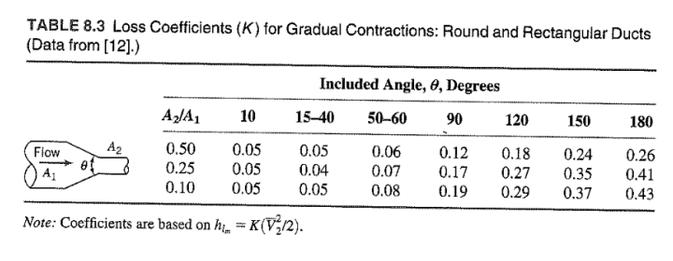
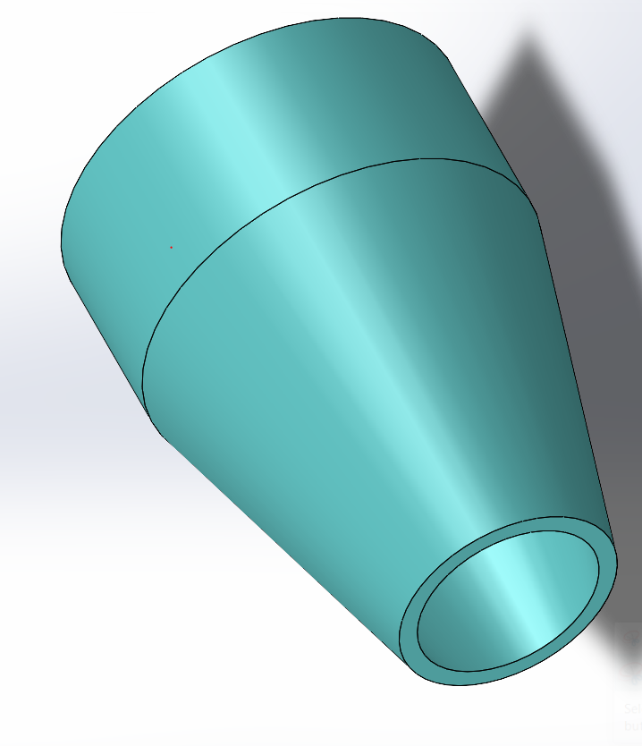
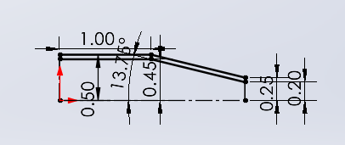
Activity 3: Nozzle Design
Based on the values, we were able to design a nozzle with the lowest possible K constant to minimize head loss. For a smaller K constant, we want a 0.25 A2/A1 ratio and a 15-40 degree angle to get a K value of 0.04 to reduce the head loss.
Smaller area means greater velocity and spray time but less force from water
Greater area increases HL and force but reduces spray time.
Initial Design:
D1 = 1.0 [in], D1.Inner = 0.9 [in], A1 = 0.16 [in²]
D2 = 0.50 [in], D2.Inner = 0.40 [in], A2 = 0.04 [in²] θ = 27.5 degrees
Chart from Ed
Nozzle Dimensions
Nozzle CAD

Slide 10
Activity 3: Nozzle Design
During initial presentations, it was revealed that designing our nozzle purely around a low K constant wasn’t the correct way to optimize.
We decided the best thing to do before competition was to test our flow with a variety of nozzles with ranging D2.Inner described below (in inches).
We tested before competition on the day of testing, using the wooden block to approximate the force generated by each nozzle. For larger diameter nozzles, we had lots of force but ran out of water quickly. For smaller nozzles, the opposite: low force but long spray time.
From testing we performed, we agreed that a nozzle with a D2 Inner of 0.4 in was ideal in terms of both force generation and water usage. Using this during our lab, we ended up winning the competition against other teams who we found traded heavier water usage for more power, which led to us winning in the long run. Our original nozzle design ended up being a general great fit for the competition.
Using the formula ∑Fx = p*((Ain/Aout)(Vin))^(2)*Aout, we can see that by increasing our Aout, we increase the Fx, which lead to us to have more force on the block, but using more water, justifying our 0.4in nozzle.
0.6 | 0.4 | 0.3 | 0.2 | 0.15

Slide 11
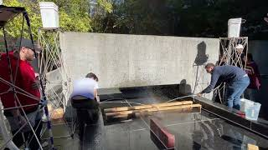
Competition Results
During our competition, we ended up winning the lab! We attributed this to 2 main reasons.
Tower Strength: Several of our opponents lost due to tower collapse, and we believe that by double cross bracing our tower, we were more structurally sound than other teams. Our addition of pre-tensed string members helped us as well, increasing our resistance to buckling
Nozzle Design: Our nozzle design was a great balance between water efficiency and power. Although we originally prioritized a small head loss, we ended up designing a nozzle that could generate enough power to hold off opponents with more powerful nozzles while they ran out of water much quicker than we did.

Slide 12
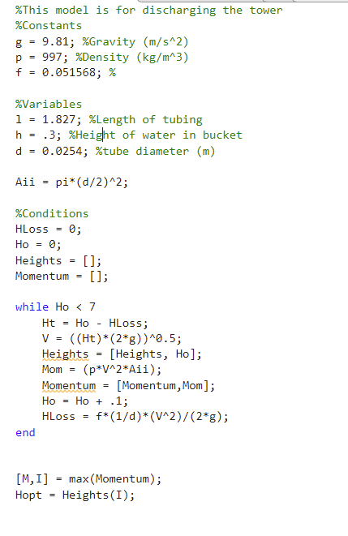
System Prediction
Here is the intended prediction for our system. Discharge made with help from Alex Mejia
Predicted bucket fill level based on the height of the tower and associated differential head
Fill time of 3.0 minutes = 180 [s]
Initial Height: 9 [ft] ~ 2.74 [m] ⇒ Q_{2.74m} = 6.39E-5 [m³/s] ⇒ V_{2.74m} = 3.04 [gal]
Final Height: 6 [ft] ~ 1.83 [m] ⇒ Q_{1.83m} = 9.43E-5 [m³/s] ⇒ V_{1.83m} = 4.48 [gal]
Compared 4.48 gal in 3 min to almost full ~4.5 gallons with 3 minutes on competition day.
Goal: Maximize H-Output and 1 in diameter pipe to minimize head loss
Discharge Model

